Slide 1
HYPERCUBE ALGORITHMS
Ram Krishna Dahal
Asst. Professor
Central Department of computer science and IT, TU

Slide 2
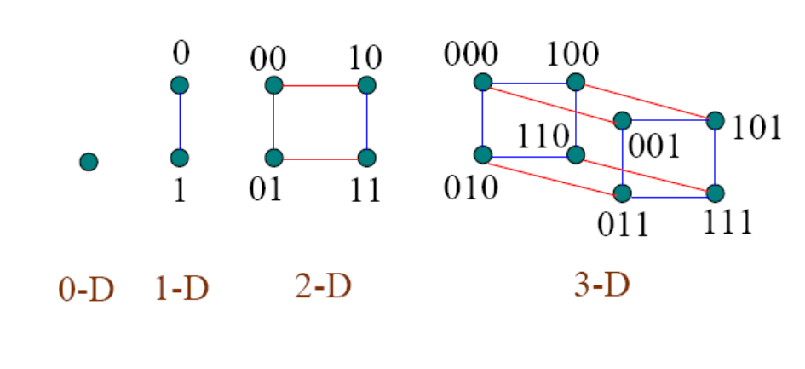
Hypercube - Computation Model

Slide 3
Computation Model
Each node of a d-dimensional hypercube is numbered using d bits. Hence, there are 2^d processors in a d-dimensional hypercube represented as H_{d}.
Two nodes are connected by a direct link if their numbers differ only by one bit
The diameter (Largest distance between any pair of nodes in the network) of a d-dimensional hypercube is d as we need to flip at most d bits (traverse d links) to reach one processor from another.
The bisection width (Minimum number of edges that must be removed in order to divide the network into two halves of equal size) of a d-dimensional hypercube is 2^(d-1)

Slide 4
The hypercube is a highly scalable architecture. Two d-dimensional hypercubes can be easily combined to form a d+1-dimensional hypercube.
Two variants of Hypercube – In, sequential hypercube, one processor can communicate only with one neighbour at a time. In parallel, it can communicate with all neighbors.
The hypercube has several variants like butterfly, shuffle-exchange network and cube-connected cycles.

Slide 5
The Butterfly Network
Algorithms for Hypercube can be adapted for Butterfly network and vice-versa.
A d-dimensional butterfly (B_{d}) has (d+1)2^d processors and d2^(d+1) links.
Processor represented as tuple <r,l>, r is row and l is level.
Each processor u, is connected to two processors in level l+1: v = <r, l+1> and w = <r^{l+1}, l+1>
(u,v) is called direct link and (u,w) is called cross link

Slide 6
The Butterfly Network
There exists a unique path of length d from u at level 0 and v at level d, called as greedy path.
Hence, diameter of butterfly network is 2d.
When each row of B_{d} is collapsed into a single processor, preserving all the links then resultant graph is a hypercube (H_{d})
Each step of B_{d} can be simulated in one step on parallel version of H_{d}.
Normal butterfly algorithm – If at any given time, processors in only level articipate, it is normal algorithm.
A single step of any normal algorithm can be simulated on sequential H_{d}

Slide 7
Embedding
A general mapping of one network G(V1, E1) into another H(v2, E2) is called embedding.
Embedding of a ring: If 0,1,2... 2^{d-1} are processors of a ring, processors 0 is mapped to processor 000...0 of the hypercube.
Mapping is obtained using gray codes.
Terminologies
Expansion = |V2|/|V1|
Dilation = Length of longest path any link of one network structure is mapped with another
Congestion = number of path on the previous network structure that it is on.

Slide 8
Embedding of a binary tree
A p-leaf (p=2^{d}) binary tree T can be embedded into H_{d}.
More than one processor of T have to be mapped into same processor of H_{d}.
If tree leaves are 0,1,2...p-1, then leaf i is mapped to i^{th} processor of H_{d}.
Each processor of T is mapped to the same processor of H_{d} as its leftmost descendant leaf

Slide 9
PPR Routing: A Greedy Algorithm
In B_{d}, Origin of packet is at level 0 and destination is level d
Greedy algorithm for each packet is to choose a greedy path between its origin and destination.
Distance travelled by any packet is d. Algorithm runs in O(2^{d/2}) time, the average queue length being O(2^{d/2})

Slide 10
Fundamental Algorithms : Broadcasting
Since, A hypercube with 2d nodes can be regarded as a d-dimensional mesh with two nodes in each dimension.
The mesh algorithm can be generalized to a hypercube and the operation is carried out in d (= log p) steps.

Slide 11
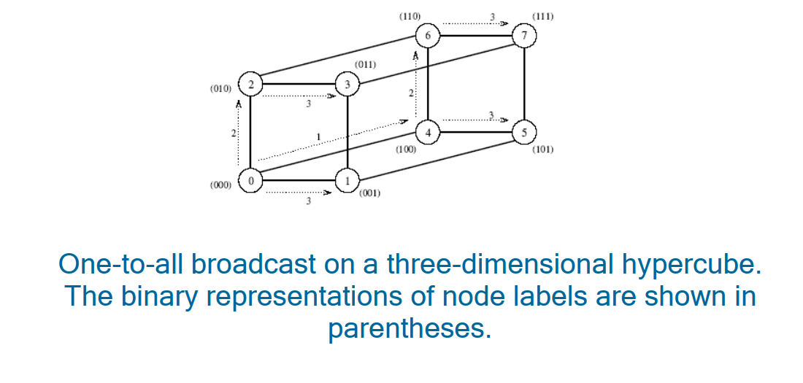
Broadcasting

Slide 12
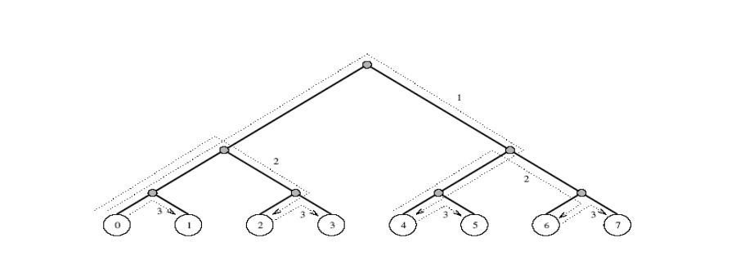
Broadcasting
In Binary tree embedding, each node makes two copies of message and sends one to left child and another to right child.

Slide 13
Assume that the message M is at 000 i.e. in the root node.
The node keeps a copy to itself and forward one copy to left and right child
Every internal node does the same until the message reaches to the leaf nodes.
This takes O(d) steps

Slide 14
Prefix Computation
Binary tree embedding can be used.
Two phases: forward phase and reverse phase
Forward phase:
The leaves start by sending their data up to their parents.
Each internal processor on receipt of two items (y is left child and z is right child) computes w=y+z, stores a copy of y and w and sends w to its parent.
At the end of d steps, each processor in the tree has stored in its memory the sum of all data items in the left subtree rooted at this processor.
The root has sum of all elements in tree

Slide 15
Prefix Computation
Reverse Phase:
The root starts by sending zero to its left child and y to its right child.
Each internal processor on receipt of a datum (say q) from its parent sends q to its left child and q+y to its right child.
When i^{th} leaf gets a datum q from its parent, it computes q+x_{i} and stores it as final result

Slide 16
Data Concentration
Assume that there are k<p items distributed arbitrarily.
Problem is to move the data into processors 0,1,2.... k-1 of Hd.
There are two phases in algorithm
First phase:
A prefix sums operation is performed to compute the destination address of each data item.
Each packet is routed to its destination using the greedy path from its origin to its destination

Slide 17
Data Concentration
In second phase, when packets are routed using greedy paths, we claim that no packet gets to meet any other in path, hence there is no contention
Data concentration can be performed on B_{d} as well as the sequential H_{d} in O(d) time

Slide 18
Selection
Given a sequence, problem is to find i^{th} smallest key from sequence.
There are two different versions: a) p=n and b) n>p
The work optimal algorithm for mesh can be adapted to run optimally on H_{d} as well.
Selection from n=p keys can be performed in O(d) time on Hd.

Slide 19
Sorting in hypercube- Odd eve merge
The problem is to take two sorted sequence and produce a sorted sequence
If the two sequences to be merged are of length m each, they can be merged in O(log m) time using a hypercube with O(m²) processors
We are interested in merging on a hypercube with only 2m processors

Slide 20
Odd even merge sort
Let X₁= k₁,k₂,….,k_{m} & X₂= k_{m+1}, k_{m+2},…..K_{2m}
Separate X₁ & X₂ into odd and even part. Let O₁, E₁ and O₂, E₂
Recursively merge E₁ with O₂ to form A=a₁,a₂,…..am and O₁and E₂ to form B=b₁,b₂,….,b_{m}
Shuffle A and B to form C= a₁,b₁,a₂,b₂,……,a_{m},b_{m}
Compare a_{i} with b_{i} and interchange if required

Slide 21
Bitonic sort in butterfly network
If p be the number of input at level d of Bd, send the data to level d-1, so that the 1st half of the input is in the left sub-butterfly and the net half is in the right sub butterfly
The left half of the input is sorted recursively in increasing order and the right half of the input is sorted in descending order
The sorted sequence will be available at level d-1 so that it sent back to level d, we have a bitonic sequence

